Slide 1

Getting started with micro:bit
DCU ICT Summer Camp 2022

Slide 2
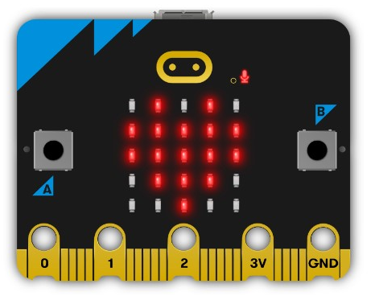
What is the micro:bit?
Pocket sized codable computer designed by BBC in 2016
Helps to understand, how software and hardware work together.
Also referred to as BBC Micro Bit.

Slide 3
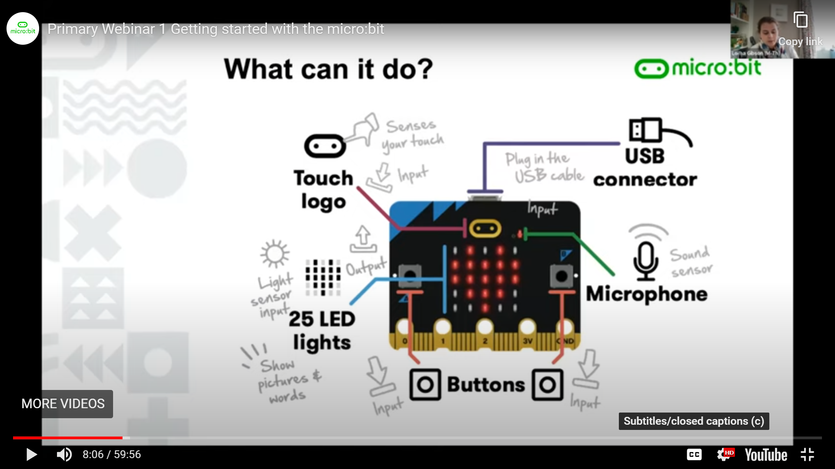
What can it do?

Slide 4
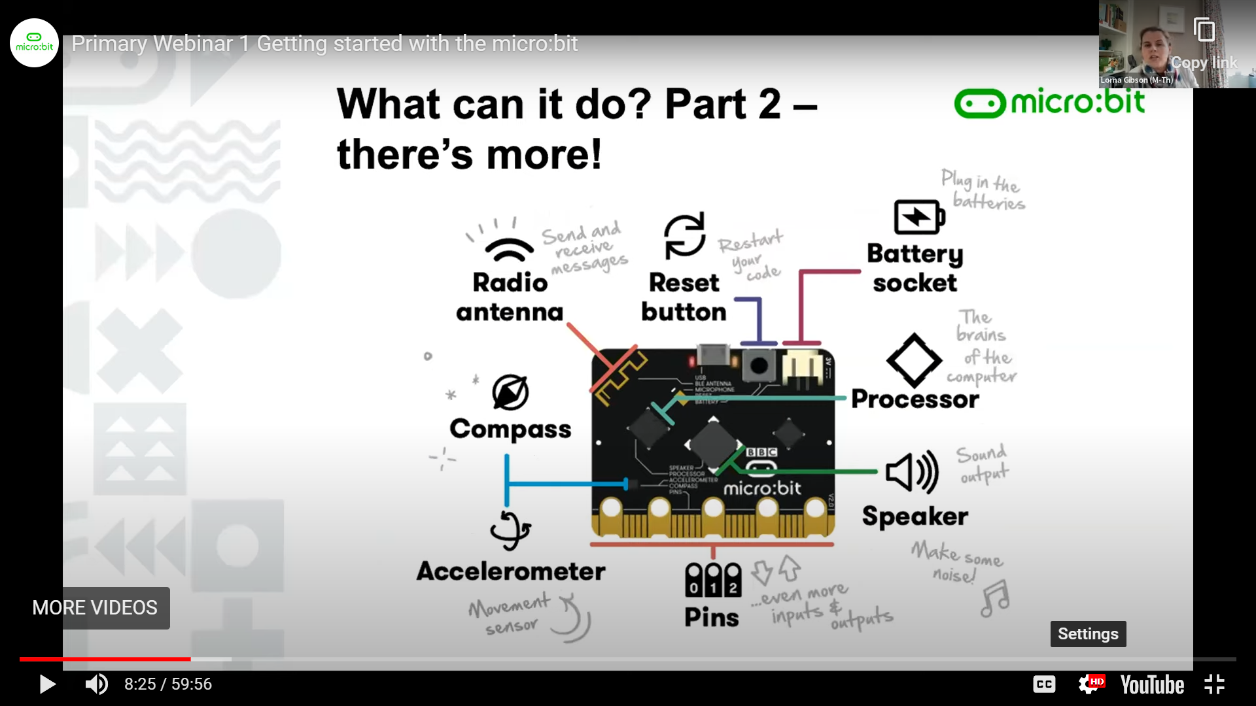
What can it do? There’s more!

Slide 5

Intro Video
https://www.youtube.com/watch?v=u2u7UJSRuko

Slide 6
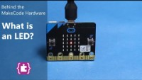
Flashing Heart
Learn how to use the LEDs and make a flashing heart! https://youtu.be/qqBmvHD5bCw?t=222

Slide 7
Let’s Make Code…
https://makecode.microbit.org/

Slide 8
Thank You…

